Slide 1
Unit-1 INTRODUCTION TO OPERATING SYTEMS

Slide 2
Roadmap
Introduction to Operating system
Operating System Objectives and functions
Evolution Of Operating System
Major achievements of Operating system

Slide 3
Operating system
Definition:-
“ An Operating system is a program that controls the execution of application program and acts as an interface between the user of a computer and the computer hardware.”

Slide 4
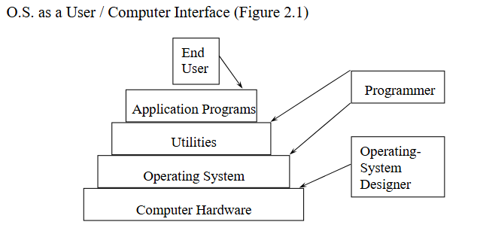
Operating system

Slide 5
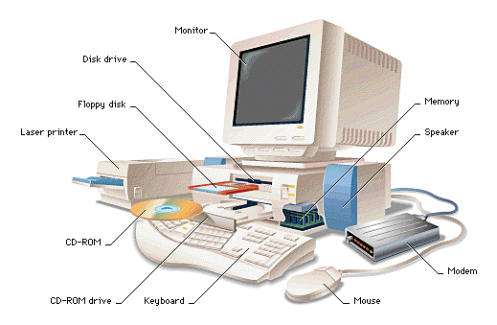

Slide 6

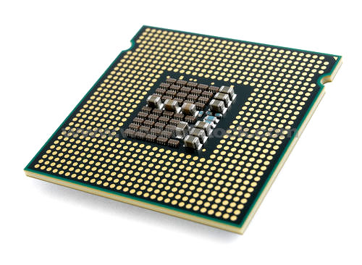
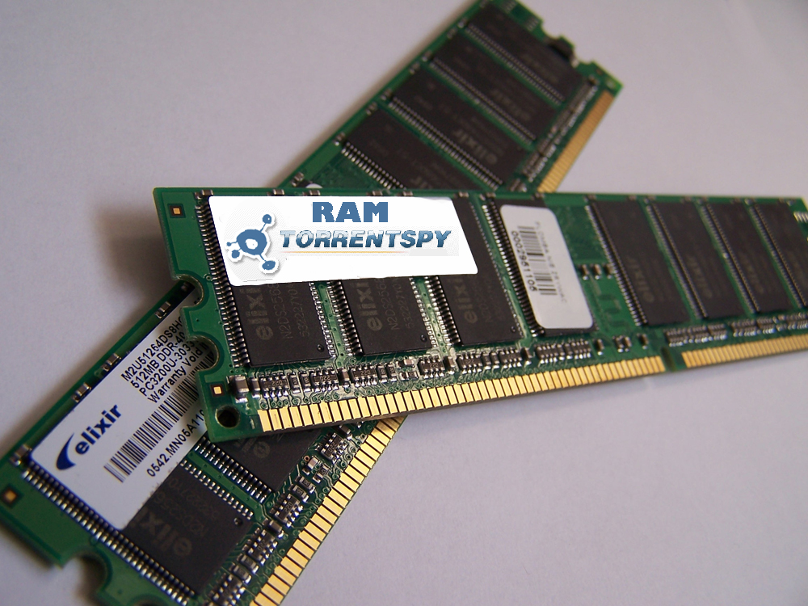

processor
RAM

Slide 7
An OS is a program which acts as an interface between computer system users and the computer hardware.
It provides a user-friendly environment in which a user may easily develop and execute programs.
Otherwise, hardware knowledge would be mandatory for computer programming.
So, it can be said that an OS hides the complexity of hardware from uninterested users.
In general, a computer system has some resources which may be utilized to solve a problem. They are
Memory
Processor(s)
I/O
File System

Slide 8
The OS manages these resources and allocates them to specific programs and users.
With the management of the OS, a programmer is rid of difficult hardware considerations.
An OS provides services for
Processor Management
Memory Management
File Management
Device Management
Concurrency Control

Slide 9
Roadmap
Introduction to Operating system,
Operating System Objectives and functions,
Evolution Of Operating System
Major achievements

Slide 10
Objectives of operating system
Convenience:-
It makes a computer more convenient to use.
Tasks can be computed easily and in less time.
Efficiency:-
It strives to utilize the computer's resources (CPU, memory, I/O devices) efficiently, minimizing waste and maximizing throughput.
Ability to evolve:-
Permits the effective development, testing and introduction of a new system functions without interfering with service.
Resource Management:- The OS acts as a manager for all the hardware and software resources, allocating them to different processes and users as needed.

Slide 11
Objectives of operating system
Evolvability:- The OS should be designed in a way that allows for future enhancements and modifications without significant disruptions to existing functionality.
Security: - Protecting the system from unauthorized access and malicious activities is a crucial objective.

Slide 12
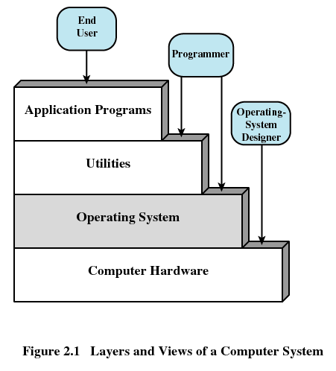

Slide 13
Let us examine these three aspects of an OS in turn
The Operating System as a User/Computer Interface (Convenience):-
The end user views a computer system in terms of a set of applications.
If an application program is to be built as a set of machine instructions than it will be more complex.
To solve this, a set of system programs is provided.
The OS hides the details of the hardware from the programmer and provides the programmer with a convenient interface for using the system.
It acts as mediator, making it easier for the programmer and for application programs to access and use those facilities and services.

Slide 14
Briefly, the OS typically provides services in the following areas:
Program development:-
It provides variety of facilities to assist the programmer E.g editors, debuggers
these services are in the form of utility programs that IS not strictly part of the OS AND supplied with the OS and are referred to as application Program development tools.
Program Execution:-
A number of steps need to be performed to execute a program like Instructions and data must be loaded into main memory I/O devices and files must be initialized, and other resources must be prepared.
The OS handles these scheduling duties for the user.

Slide 15
Access to I/O devices:-
Each I/O device requires its own peculiar set of instructions or control signals for operation.
The OS provides a uniform interface that hides these details
so that programmers can access such devices using simple reads and writes..
Controlled access to files:
For file access, the OS must reflect a detailed understanding of not only the
nature of the I/O device (disk drive, tape drive) but also the structure of the
data contained in the files on the storage medium.
In the case of a system with multiple users, the OS may provide protection
mechanisms to control access to the files.

Slide 16
System access:-
For shared or public systems, the OS controls access to the system as a
whole and to specific system resources.
The access function must provide protection of resources and data from
unauthorized users and must resolve conflicts for resource contention.
Error detection and response:-
A variety of errors can occur while a computer system is running like hardware
errors(memory error, device failure) and various software errors(division by
zero, attempt to access forbidden memory location).
The OS must provide a response that clears the error condition with the least
impact on running applications.
Like ending the program that caused the error, to retrying the operation, to
simply reporting the error to the application.

Slide 17
Accounting:-
A good OS will collect usage statistics for various resources and monitor
performance parameters such as response time.
On any system, this information is useful in anticipating the need for future
enhancements and in tuning the system to improve performance.
On a multiuser system, the information can be used for
billing purposes.

Slide 18
2) The Operating System as Resource Manager (Efficiency)
A computer is a set of resources for the movement, storage, and processing of data and for the control of these functions.
The OS is responsible for managing these resources.
OS controls in two respects:
The OS functions in the same way as ordinary computer software; that is, it is a program or suite of programs executed by the processor.
The OS frequently relinquishes control and must depend on the processor to allow it to regain control.
The OS directs the processor in the use of the other system resources and in the timing of its execution of other programs.

Slide 19
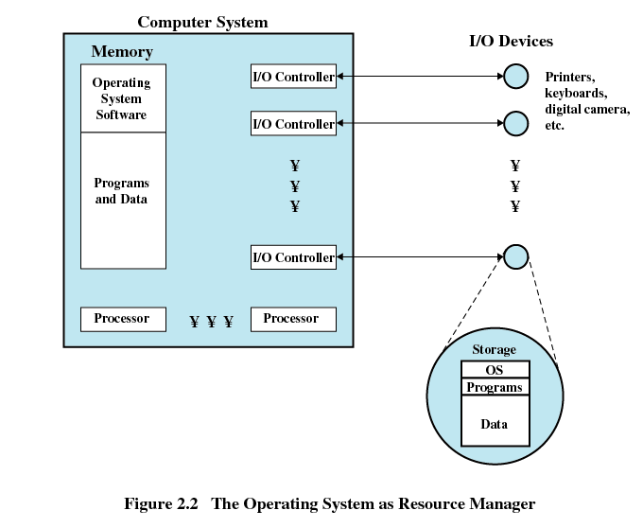

Slide 20
Figure 2.2 suggests the main resources that are managed by the OS
A portion of the OS is in main memory.
This includes the kernel, or nucleus, which contains the most frequently used
functions in the OS and, at a given time, other portions of the OS currently in
use.
The remainder of main memory contains user programs and data.
The allocation of this resource (main memory) is controlled jointly by the OS
and memory management hardware in the processor.
The OS decides when an I/O device can be used by a program in execution and controls access to and use of files.
The processor itself is a resource, and the OS must determine how much
processor time is to be devoted to the execution of a particular user program.

Slide 21
Operating system evolution
A major operating system will evolve over time for a number of reasons:-
Hardware upgrades plus new types of hardware:-
In Early operating systems paging mechanism as well as graphics
terminal and page mode terminals was not there.
In newer o.s this facility was introduced for e.g. a graphics terminal typically allows the user to view several applications at the same time through “windows” on the screen. This requires more sophisticated support in the OS.
New services:
In response to user demand or in response to the needs of system managers, the OS expands to offer new services.
Fixes:
Any OS has faults. These are discovered over the course of time and fixes are made.

Slide 22
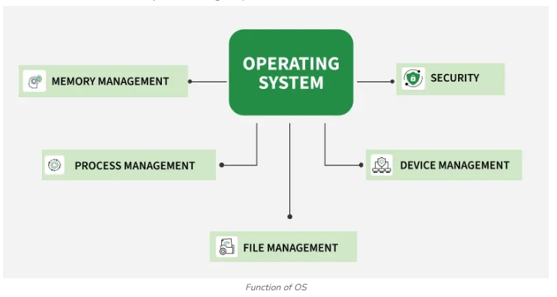
FUNCTIONS of operating system

Slide 23
1. Process Management
Process management in operating system is about managing processes. A Process is a running program. The life cycle of process is from the moment program start until it finishes. Operating system makes sure each process:
gets its turn to use the CPU
synchronized when needed
has access to the resources it needs, like memory, files, and input/output devices.
It also handles issues like process coordination and communication, while preventing conflicts such as deadlocks. This way, the OS ensures smooth multitasking and efficient resource use.
Process Scheduling
Allocates CPU time to processes based on scheduling algorithms like Round Robin or Priority Scheduling.
Ensures fair distribution of CPU time, avoiding starvation of lower-priority processes.
Maximizes CPU utilization by determining which process runs at any given time.

Slide 24
1. Process Management
Process Synchronization
Coordinate multiple processes to ensure orderly execution and prevent conflicts.
Prevents race conditions by ensuring that only one process can access a shared resource at a time.
Uses synchronization mechanisms like locks, semaphores, and monitors to coordinate process access.
Deadlock Handling
Prevents deadlocks by using strategies like resource allocation graphs or avoiding circular wait conditions.
Detects deadlocks when they occur, allowing the system to identify and resolve the issue.
Recovers from deadlocks by aborting or rolling back processes to free up resources.

Slide 25
2. Memory Management
Memory management is an essential task of the operating system that handles the storage and organization of data in both main (primary) memory and secondary storage. The OS ensures that memory is allocated and deallocated properly to keep programs running smoothly. It also manages the interaction between volatile main memory and non-volatile secondary storage.
Key Activities in Memory Management:
Main Memory Management
Memory Allocation: Assigns memory to processes using techniques like paging and segmentation.
Memory Deallocation: Frees memory when no longer needed.
Memory Protection: Prevents processes from accessing each other’s memory.
Virtual Memory: Uses disk space as extra memory to run larger processes.
Fragmentation: Manages wasted memory space (internal/external) through compaction.

Slide 26
2. Memory Management
Secondary Memory Management
Disk Space Allocation: Organizes how files are stored on the disk (contiguous, linked, indexed).
File System Management: Manages files and directories for efficient data access.
Free Space Management: Tracks available space on the disk.
Disk Scheduling: Organizes the order of disk read/write requests.
Backup and Recovery: Ensures data is backed up and can be restored after failure.

Slide 27
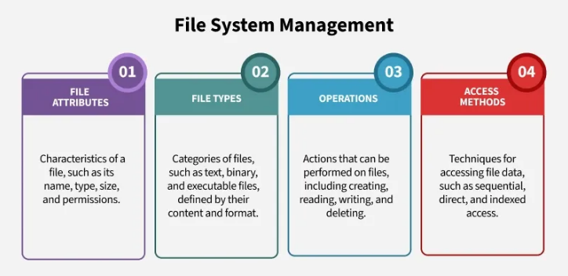
3. File System Management
File management in the operating system ensures the organized storage, access and control of files.
The OS abstracts the physical storage details to present a logical view of files, making it easier for users to work with data.
It manages how files are stored on different types of storage devices (like hard drives or SSDs) and ensures smooth access through directories and permissions.

Slide 28
3. File System Management
File System Management includes managing of:
File Attributes
File Name: Identifies the file with a name and extension (e.g., .txt, .jpg).
File Type: Defines the format of the file (e.g., text, image, executable).
Size: The amount of storage the file occupies.
Permissions: Determines who can read, write, or execute the file.
File Types
Text Files: Contain human-readable content (e.g., .txt, .md).
Binary Files: Store data in binary format (e.g., .jpg, .mp3).
Executable Files: Contain program code (e.g., .exe, .out).

Slide 29
3. File System Management
Operations on Files
Create: Allows users to create new files.
Read: Opens files to read their contents.
Write: Modifies the contents of a file.
Delete: Removes a file from the system.
Access Methods
Sequential Access: Reads data in order, from start to finish.
Direct Access: Jumps to a specific part of the file.
Indexed Access: Uses an index for quick data retrieval.

Slide 30
4. Device Management (I/O System)
Device management of an operating system handles the communication between the system and its hardware devices, like printers, disks or network interfaces.
The OS provides device drivers to control these devices, using techniques like Direct Memory Access (DMA) for efficient data transfer and strategies like buffering and spooling to ensure smooth operation.
Major components in Device Management:
Device Drivers: The operating system uses device drivers to interact with hardware devices. There are two types of device drivers:
Kernel-space drivers run in the OS kernel, offering direct access to hardware.
User-space drivers run outside the kernel and are more isolated, providing safety but less performance.

Slide 31
4. Device Management (I/O System)
Buffering & Caching:
Buffering temporarily stores data in memory to manage differences in device speeds. Block devices (e.g., hard drives) use larger blocks of data for buffering, while character devices (e.g., keyboards, mice) use smaller, byte-by-byte buffering.
Caching improves access speed by storing frequently accessed data in a faster storage medium (like RAM).
Spooling: Spooling manages data waiting to be processed, particularly in devices like printers. The OS places print jobs in a spool (a temporary storage area), allowing the CPU to continue other tasks while the printer works through the queue. Other examples include mail spooling (for managing outgoing email) and batch-job spooling (for managing scheduled tasks).

Slide 32
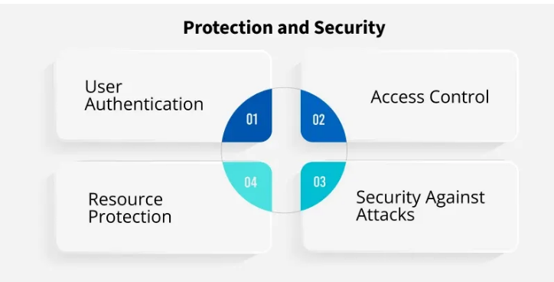
5. Protection and Security
Protection and security mechanisms in an operating system are designed to safeguard system resources from unauthorized access or misuse.
These mechanisms control which processes or users can access specific resources (such as memory, files, and CPU time) and ensure that only authorized users can perform specific actions.
While protection ensures proper access control, security focuses on defending the system against external and internal attacks.

Slide 33
5. Protection and Security
Access Control: The operating system ensures that processes and users can only access resources they are authorized to. This is achieved through mechanisms like memory-addressing hardware (which keeps processes within their own address space) and timer interrupts (which prevent processes from monopolizing the CPU).
User Authentication: A system identifies users through user IDs (UIDs) or Security IDs (SIDs). During login, the operating system verifies the user’s credentials, ensuring that only authorized users can access their data or system resources.
Resource Protection: Mechanisms like file protection (ensuring only authorized users can access or modify files) and device protection (restricting direct access to device-control registers) ensure the integrity of system resources, preventing unauthorized or harmful use.
Security Against Attacks: Security mechanisms defend against external threats like viruses, worms, denial-of-service attacks, and identity theft. These attacks can misuse system resources, steal sensitive data, or disrupt system operation. The OS works to prevent these threats and minimize damage.

Slide 34
Roadmap
Introduction to Operating system,
Operating System Objectives and functions,
Evolution Of Operating System
Major achievements

Slide 35
Evolution of operating system
The following sequence shows how operating systems have evolved over the years.
Serial Processing
Simple Batch System
Multiprogrammed Batch Systems
Time-sharing Systems

Slide 36
1. Serial processing
Definition:-
Processing information where only the one process of operation is carried out at one time.
This mode of operation could be termed serial processing, reflecting the fact that users have access to the computer in series.
No operating system
Machines run from a console with display lights, toggle switches, input device,
and printer
Schedule time
Setup included loading the compiler, source program, saving compiled program,
and loading and linking
As time went on, card readers, printers, and magnetic tape units were developed as
additional hardware elements.
Assemblers, loaders and simple utility libraries were developed as software tools.

Slide 37
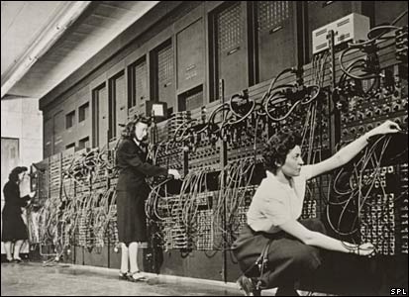
1. Serial processing
Example of serial processing is ENIAC. It all started with computer hardware in about 1940s

Slide 38
eniac
ENIAC (Electronic Numerical Integrator and Computer), at the U.S. Army's Aberdeen Proving Ground in Maryland.
Built in the 1940s,
Weighed 30 tons,
Was eight feet high, three feet deep, and 100 feet long
Contained over 18,000 vacuum tubes that were cooled by 80 air blowers.

Slide 39
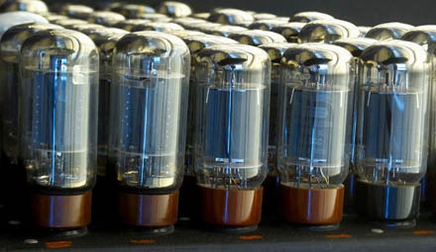
1. Serial processing
Computers were using vacuum tube technology
ENIAC’s vacuum tubes

Slide 40
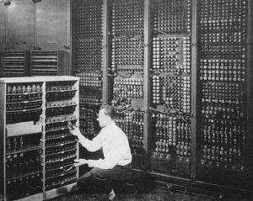
1. Serial processing
ENIAC’s backside

Slide 41
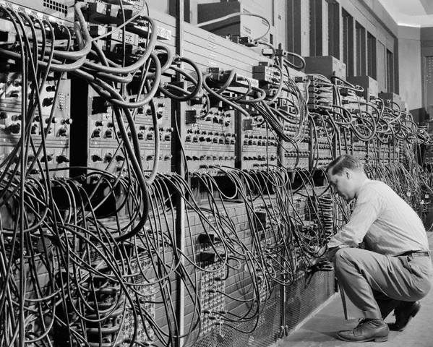
f
1. Serial processing
Programs were loaded into memory manually using switches, punched cards, or paper tapes.
ENIAC : coding by cable connections

Slide 42
1. Serial processing
These early systems presented two main problems:
1) Scheduling:
Most installations used a hardcopy sign-up sheet to reserve computer time.
Typically, a user could sign up for a block of time in multiples of a half hour or so.
A user might sign up for an hour and finish in 45 minutes; this would result in wasted computer processing time.
2) Setup time:-
A single program (job) requires so many steps and if any error occurs, user typically had to go back to the beginning of the setup sequence.
Thus, a considerable amount of time was spent just in setting up the program to run.

Slide 43
2. Simple batch system
To minimize the problem of serial processing and to improve utilization, the concept of a
batch operating system was developed.
Def :- A batch system is a when a computer is programmed to batch together a number of transactions for processing at a specific time.
The operator batched similar jobs together and then ran in the computer to speed up the
processing.
The user submits the job on cards or tape to a computer operator, who batches the jobs
together sequentially and places the entire batch on an input device, for use by the
monitor.
What is a MONITOR?
It is the batch operating system.
Software that controls the sequence of events
Batch jobs together
Program branches back to monitor when finished

Slide 44
2. Simple batch system
With each job, instructions are included in a primitive form of job control language (JCL).
Special type of programming language Provides instruction to the monitor
What compiler to use
What data to use

Slide 45
2. Simple batch system
To understand how this scheme works, let us look at it from two points of view:
Monitor point of view:
The monitor controls the sequence of events.
For this much of the monitor must always be in main memory for execution (Fig 2.3) and that portion is referred to as the resident monitor.
The monitor reads in jobs one at a time from the input device
As it is read in, the current job is placed in the user program area, and control is passed to this job.
When the job is completed, it returns control to the monitor, which immediately reads in the next job.
The results of each job are sent to an output device, such as a printer, for delivery to the user.

Slide 46
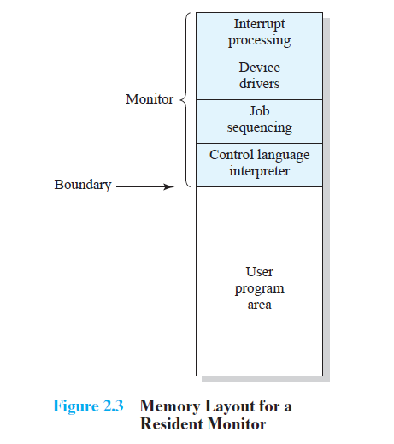
2. Simple batch system

Slide 47
Simple batch system
Processor point of view:
Once a job has been read in, the processor will encounter a branch instruction in the monitor that instructs the processor to continue execution at the start of the user program.
The processor will then execute the instructions in the user program until it encounters an ending or error condition.
The monitor performs a scheduling function:
A batch of jobs is queued up, and jobs are executed as rapidly as possible, with no intervening idle time.

Slide 48
Simple batch system
Certain other hardware features are also desirable:
Memory protection
Do not allow the memory area containing the monitor to be altered
by the user program
Timer
Prevents a job from monopolizing the system
The timer is set at the beginning of each job. If the timer expires, the
user program is stopped, and control returns to the monitor.
Privileged instructions
Certain machine level instructions can only be executed by the
monitor otherwise an error occurs causing control to be transferred
to the monitor.
Interrupts
Early computer models did not have this capability.
This feature gives the OS more flexibility in relinquishing control to and regaining control from user programs.

Slide 49
Simple batch system
User program executes in user mode
Certain instructions may not be executed
Monitor executes in system mode
Kernel mode
Privileged instructions are executed
Protected areas of memory may be accessed
With a batch operating system, processor time alternates between execution of user programs and execution of the monitor.
There have been two sacrifices:
Some main memory is now given over to the monitor and
some processor time is consumed by the monitor.
Despite this the simple batch system improves utilization of the computer.

Slide 50
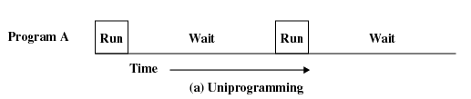
Uniprogramming:-
In a single application system, uniprogramming, the processor spends a certain amount of time executing, until it reaches an I/O instruction.
It must then wait until that I/O instruction concludes before proceeding.
This inefficiency is not necessary

Slide 51
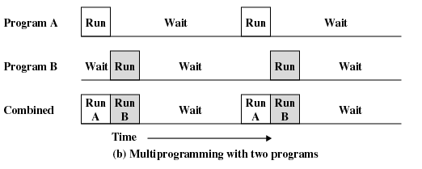
MultiProgrammed batch system
Multiprogramming:-
We know that there must be enough memory to hold the OS (resident monitor) and one user program.
Suppose that there is room for the OS and two user programs.
When one job needs to wait for I/O, the processor can switch to the other job, which is likely not waiting for I/O (Figure 2.5b).

Slide 52
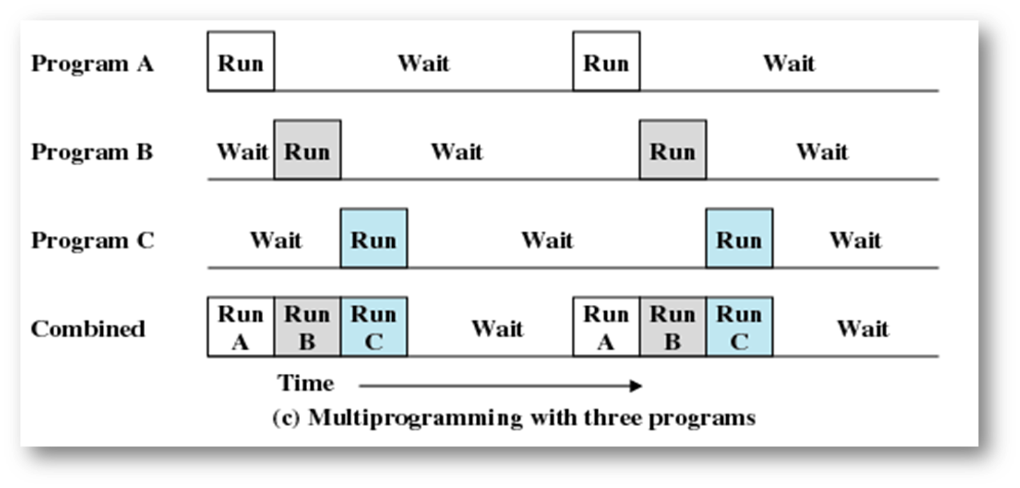
MultiProgrammed batch system
Multiprogramming with three programs:-
Further-more, we might expand memory to hold three, four, or more programs
and switch among all of them (Figure 2.5c).
The approach is known as multiprogramming, or multitasking.
It is the central theme of modern operating systems.

Slide 53
Time sharing system
With the use of multiprogramming, batch processing can be quite efficient.
For many jobs, it is desirable to provide a mode in which the user interacts directly with the computer.
Today, this requirement met by the use of a dedicated personal computer.
That option was not available in the 1960s, when most computers were big and
costly.
So Time sharing was developed.
Multiprogramming can also be used to handle multiple interactive jobs.
This technique is referred to as time sharing, because processor time is shared
among multiple users.

Slide 54
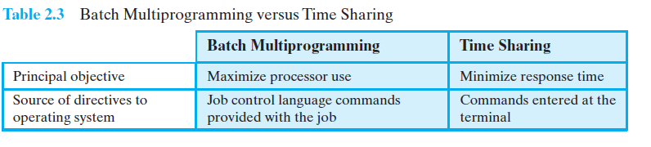
Time sharing system

Slide 55
Time sharing system
Programs queued for execution in FIFO order.
Like multiprogramming, but timer device interrupts after a quantum (time slice).
Interrupted program is returned to end of FIFO
Next program is taken from head of FIFO
Control card interpreter replaced by command language interpreter.
When OS finishes execution of one command, it seeks the next control statement from user.

Slide 56
Example Time Sharing System
Early Example: CTSS
• Compatible Time-Sharing System (CTSS)
Developed at MIT as project MAC
• Time Slicing:
– When control was passed to a user
– User program and data loaded
– Clock generates interrupts about every 0.2 sec
– At each interrupt OS gained control and could assign processor to another user

Slide 57
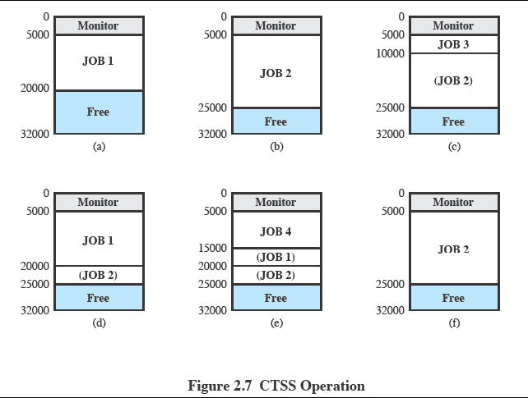

Slide 58
Assume that there are four interactive users with the following memory requirements, in words:
• JOB1: 15,000 • JOB2: 20,000
• JOB3: 5000 • JOB4: 10,000
The monitor loads JOB1 and transfers control to it (a).
Later, the monitor decides to transfer control to JOB2 as it requires more memory than JOB1. JOB1 must be written out first, and then JOB2 can be loaded (b).
Next, JOB3 is loaded in to be run. Because JOB3 is smaller than JOB2, a portion of
JOB2 can remain in memory, reducing disk write time (c).
Later, the monitor decides to transfer control back to JOB1.An additional portion of JOB2 must be written out when JOB1 is loaded back into memory (d).
When JOB4 is loaded, part of JOB1 and the portion of JOB2 remaining in memory are retained (e).
At this point, if eitherJOB1 or JOB2 is activated, only a partial load will be required.
In this example, it is JOB2 that runs next.
This requires that JOB4 and the remaining resident portion of JOB1 be written out and that the missing portion of JOB2 be read in (f).

Slide 59
Time sharing system
Problems and Issues
Multiple jobs in memory must be protected from each other’s data
File system must be protected so that only authorised users can
access
Contention for resources must be handled
Printers, storage etc

Slide 60
Roadmap
Introduction to Operating system,
Operating System Objectives and functions,
Evolution Of Operating System
Major achievements

Slide 61
Major achievement
Operating Systems are among the most complex pieces of software ever developed.
Major Advances include
I. Processes
II. Memory management
III. Information protection and security
IV. Scheduling and resource management
V. System structure
I. Process:
Fundamental to the structure of OS IS A PROCESS..
A program in execution
An instance of a program running on a computer
A single sequential thread of execution

Slide 62
Causes of Errors when Designing System Software
Error in designing an OS are often subtle and difficult to diagnose
Errors typically include:
Improper synchronization
Failed mutual exclusion
Non-determinate program operation
Deadlocks
Components of a Process :-
A process consists of
– An executable program
– Associated data needed by the program
– Execution context of the program (or “process state”)
The execution context contains all information the operating system needs to manage the process

Slide 63
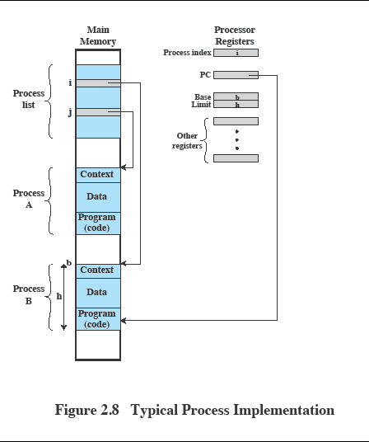
Process management

Slide 64
In Figure 2.8, the process index register indicates that process B is executing.
Process A was temporarily interrupted.
The contents of all the registers at the moment of A’s interruption were recorded in
its execution context.
The process switch consists of storing the context of B and restoring the context of A.
When the program counter is loaded with a value pointing into A’s program area,
process A will automatically resume execution.

Slide 65
II. Memory management
The OS has 5 principal storage management responsibilities
1. Process isolation:-
The OS must prevent independent processes from interfering with each other’s memory, both data and instructions.
Automatic allocation and management:-
Programs should be dynamically allocated across the memory hierarchy as required.
3. Support of modular programming:-
Programmers should be able to define program modules, and to create, destroy, and alter the size of modules dynamically.

Slide 66
4. Protection and access control:-
Sharing of memory, at any level of the memory hierarchy, creates the potential for one program to address the memory space of another.
5. Long-term storage:-
Many application programs require means for storing information for extended periods of time, after the computer has been powered down.
Virtual Memory:-
Virtual memory refers to the technology in which some space in hard disk is used as an extension of main memory. As shown in the fig 2.9

Slide 67
III. Information PROTCTION & SECURITY
We are concerned with the problem of controlling access to computer
systems and the information stored in them.
Main issues are:
– Availability:-
Concerned with protecting the system against interruption
– Confidentiality:-
Assures that users cannot read data for which access is unauthorized
– Data integrity:-
Protection of data from unauthorized modification
– Authenticity:-
Concerned with the proper verification of the identity of users and the validity of messages or data

Slide 68
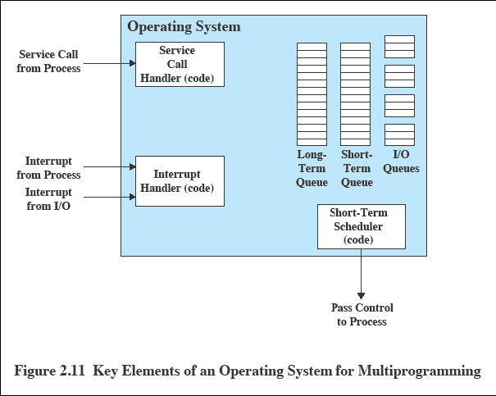
IV. SCHEDULING & RESOURCE MANAGEMENT

Slide 69
Key elements of o.s. in Multiprogramming
Figure 2.11 suggests the major elements of the OS involved in the scheduling of processes and the allocation of resources in a multiprogramming environment.
The OS maintains a number of queues, each of which is simply a list of processes waiting for some resource.
The short-term queue:-
Consists of processes that are in main memory and are ready to run as soon as the processor is made available.
The long-term queue:-
Consists of a list of new jobs waiting to use the processor.
The I/O queue:-
For each Input Output Device.
All processes waiting to use each device are lined up in that device’s queue.

Slide 70
v. System structure
View the system as a series of levels.
Each level performs a related subset of functions.
Each level relies on the next lower level to perform more primitive functions.
This decomposes a problem into
Level 1:
Consists of electronic circuits, where the objects that are dealt with are registers, memory cells, and logic gates
Level 2:
The processor’s instruction set
Level 3:
Adds the concept of a procedure or subroutine, plus the call/return operations.

Slide 71
Level 4:
Introduces interrupts, which cause the processor to save the current context and invoke an interrupt-handling routine.
These first four levels are not part of the OS but constitute the processor hardware a number of more manageable sub problems.

Slide 72
